Slide 1
Lottery Numbers
Staci McDuffie
DSC 640: Data Presentation & Visualization
July 27, 2025
Professor Schneider

Slide 2
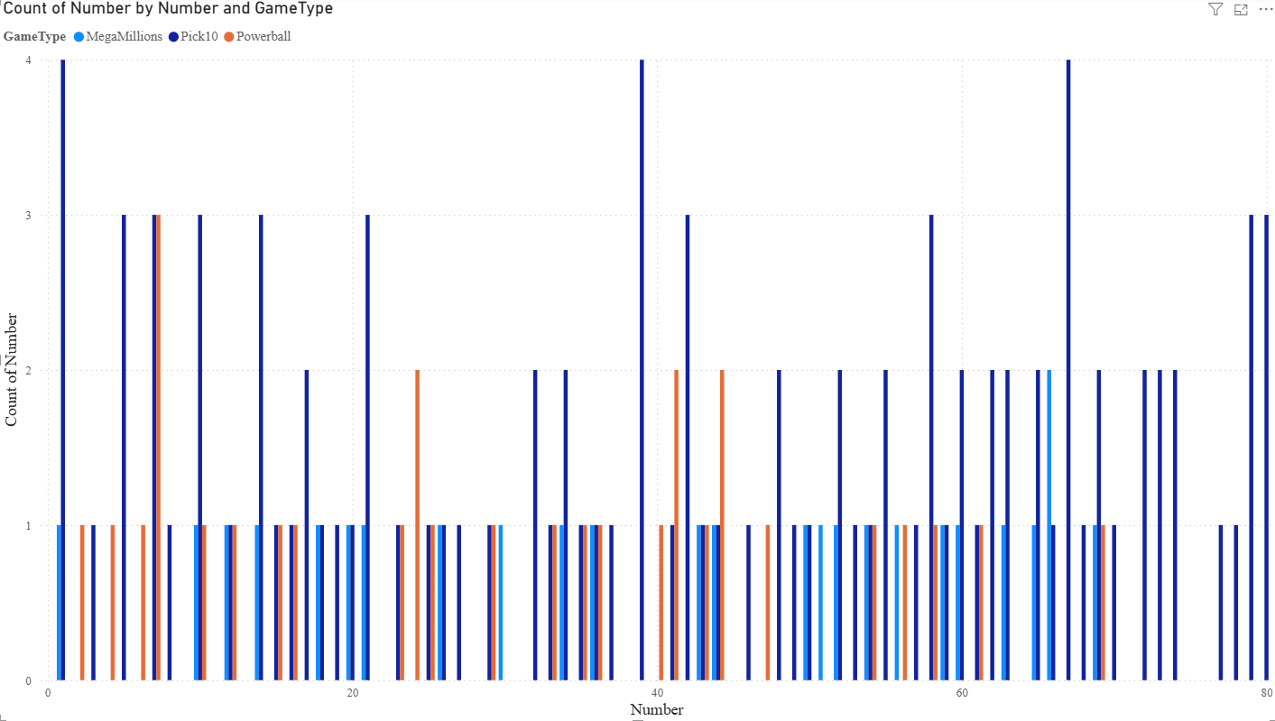
Histogram – Frequency of Winning Numbers

Slide 3
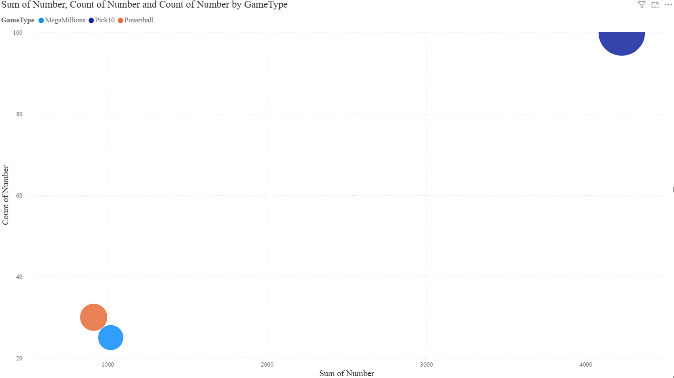
Bubble Chart – Popular Numbers by Game

Slide 4
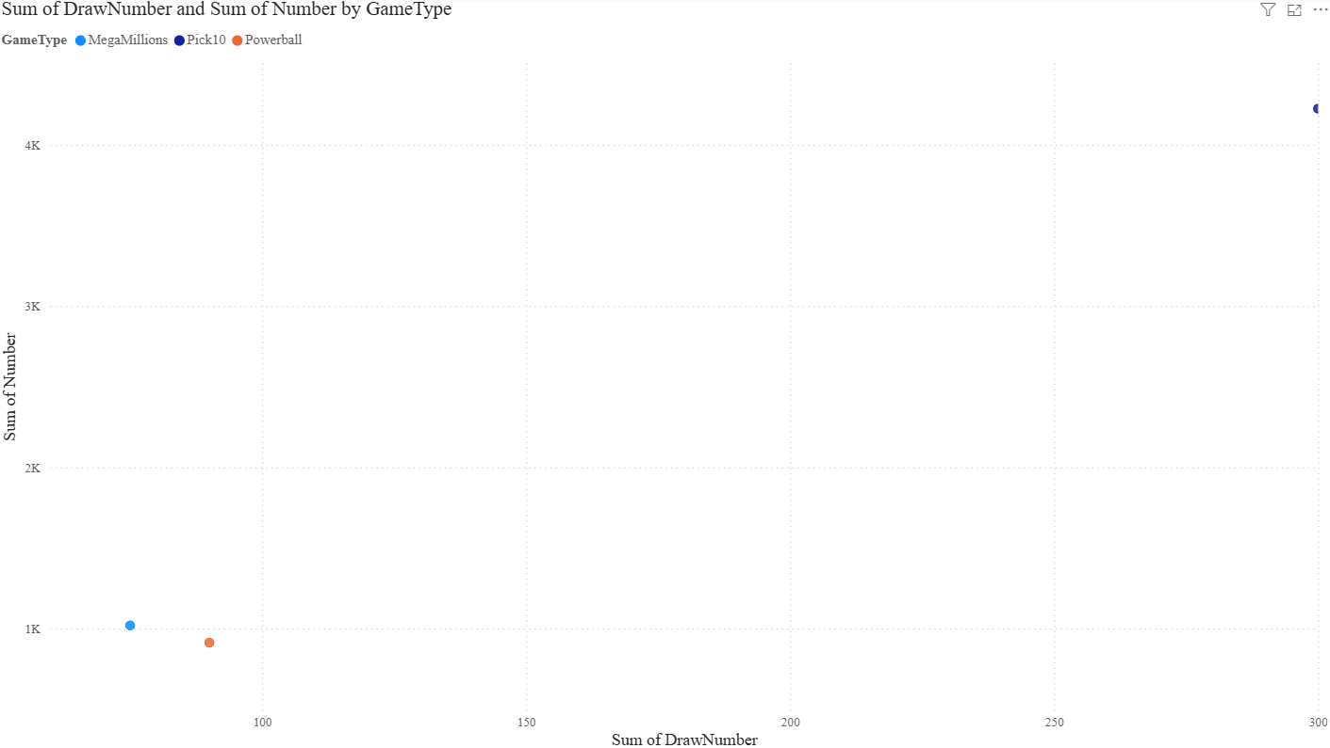
Scatterplot – Number vs DrawNumber

Slide 5
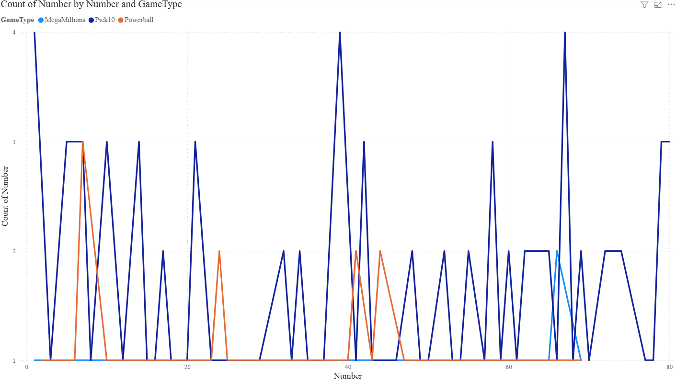
Density Proxy – Line Chart of Most Drawn Numbers

Slide 6
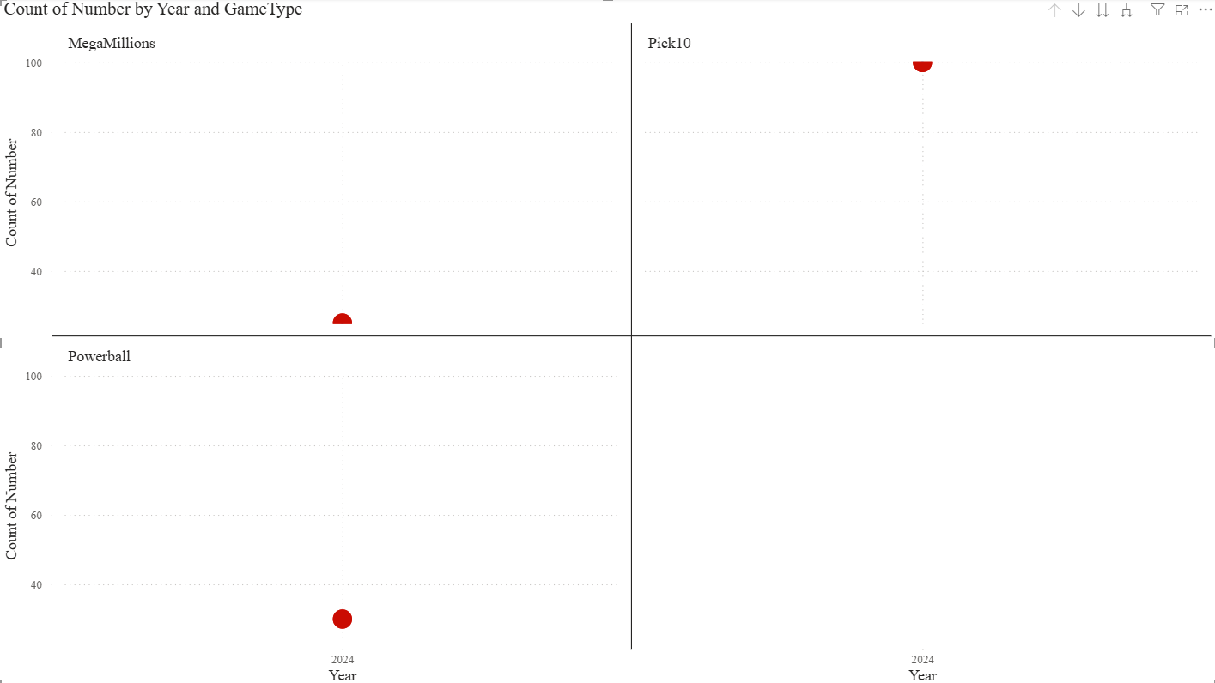
Small Multiples – Draw Patterns by Game

Slide 7
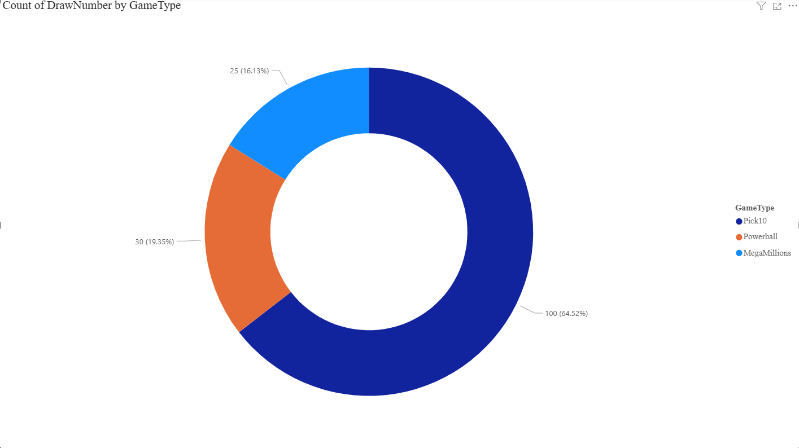
Donut Chart – Share of Draws by Game Type

